Slide 1
Eclipse IDE and Debugging
The Build Process:
Makefiles and beyond
Ravikishore Kommajosyula
Ravikishore Kommajosyula

Slide 2
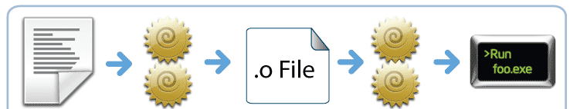
The build process
Creating executable from source code and/or libraries
Compilation: Compiling source code to object files
Linking: Linking several object files into a binary
Libraries as pre-compiled object files

Slide 3

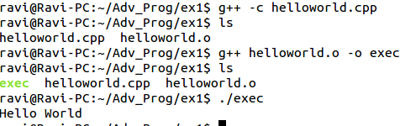
Build process in Terminal – Single file
Compiling and Linking in one step:
Compile and Link separately:

Slide 4
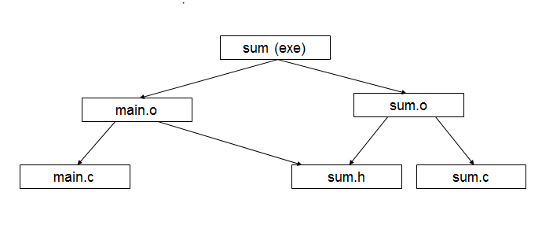
Build process – Multiple files
Function declaration is needed at compile time (header files)
Function definition is needed at linking time (object files)

Slide 5

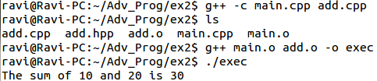
Build process in Terminal – Multiple files
Compiling and Linking in one step:
Compile and Link separately:

Slide 6
Build process in Terminal – Observations
Tedious efforts of typing involved
Error prone
Not suitable for large projects
Any change in the code would need a re-compilation of the whole code
Is there a smarter way??
Make is one answer

Slide 7
Make utility and Makefile
Make: A utility that automates the build process
Makefile: Special format file that contains Rules on how to build the executable (target)
Widely used utility especially in Unix based OS
Several tools available to generate Makefiles (CMake)
Eclipse creates Makefiles and supports projects with user defined Makefiles

Slide 8
Our first Makefile
Makefile works on a set of rules
By default, builds the target of the first rule
Rules define how “Targets” should be build from “Dependencies”
Rule syntax:
Rule for building Helloworld:
Target : Dependencies
Command
exec : helloworld.c
g++ helloworld.cpp -o exec

Slide 9
Syntax of a Makefile
Makefile contains the following 5 things:
Explicit Rules – Defines how a target is to be built from dependencies
Implicit Rules – Routinely used customary techniques without specifying in detail
Variable Definitions – for text substitutions
Directives – Direct Makefile to do special things like reading another Makefile, conditional jumps
Comments – all line starting with a #

Slide 10
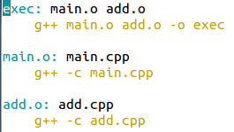

Makefile by examples
Compile and Link Multiple files – Only Explicit Rules:

Slide 11
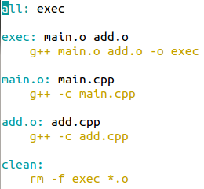
Makefile – Multiple targets
Makefile can have several targets
Standard practice to have “all”, “release”, “debug” and “clean” targets
Debug target is a good way to hide print statements in release

Slide 12

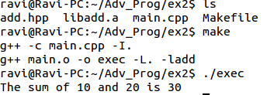
Makefile – Using external libraries
Recap: Header files at compilation, Object files at linking
Specify the path of include files at compile time
Specify the path of library and the library name at linking

Slide 13
Makefile – Using variables
Normal variables - Text Substitutions
CFLAGS = -O1 –Wall –Werror –std=c++11
Value of variables can be modified / appended
CFLAGS += -DDEBUG_FLAG
Automatic variables – limited scope in the recipe
Variable | Functionality
$@ | File name of the target of rule
$< | First dependency
$^ | Name of all dependencies
$? | All dependencies newer than target

Slide 14


Makefile – Substitution references
Substitutes the value of variable with alterations specified
Replaces every ‘a’ at the end of the word with ‘b’ for the variable var
Example –

Slide 15


Makefile – Inference rules
One form of implicit rules to perform frequently done tasks
Using inference rules, we can write –
Where $< refers to dependencies out of date

Slide 16
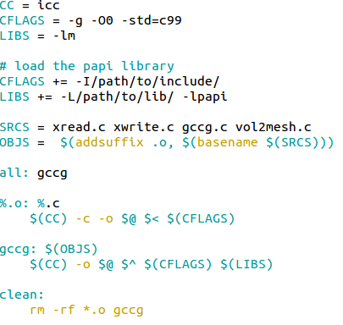
Makefile – Final Example
Define Variables
Append variables to link PAPI library
Create list of OBJS from SRCS
Make default target
Build object files
Link object files to get the binary
Make target (clean)

Slide 17
Outlook: Beyond Makefiles
Makefiles are almost the de-facto standard for build system, especially in UNIX based OS and have several advantages…….However……
Makefiles have some disadvantages:
Cryptic syntax and not easy to code
Portability is an issue with Makefiles
Recursive Make with subfolders in a project could be dangerous
Environment variables affect the build process and in some cases is difficult to reproduce
Notes:
PortabilityMake largely depends on embedded shell scripts to create the target from the dependencies. This makes Makefiles non-portable across systems that have completely different shells, like Linux and Windows.
ReliabilityIn a project consisting of a tree folders, a common technique is to employ hierarchical Makefiles. The problem with this approach is that, when make is building a sub-folder it does to have the complete view of the dependency graph. This leads to incorrect builds. This problem is described in more detail in the paper Recursive Make Considered Harmful
ReproducibilityOS environment variables can greatly affect the build, since make automatically converts all OS environment variables into make variables. The build can vary between systems depending the values set in the environment variables.

Slide 18
Outlook: Make alternatives
CMake: Cross-platform Makefile generator
(+) Write directives to build the project at a higher level
(+) Cross platform support
(-) Re-inventing the wheel by developing a new language
(-) Could be tedious to learn / migrate
Scons: Cross-platform software construction tool
Based on python
Automatically analyzes source code file dependencies and operating system adaptation requirements
Tipped to replace Make as the default build system
Notes:
PortabilityMake largely depends on embedded shell scripts to create the target from the dependencies. This makes Makefiles non-portable across systems that have completely different shells, like Linux and Windows.
ReliabilityIn a project consisting of a tree folders, a common technique is to employ hierarchical Makefiles. The problem with this approach is that, when make is building a sub-folder it does to have the complete view of the dependency graph. This leads to incorrect builds. This problem is described in more detail in the paper Recursive Make Considered Harmful
ReproducibilityOS environment variables can greatly affect the build, since make automatically converts all OS environment variables into make variables. The build can vary between systems depending the values set in the environment variables.

Slide 19
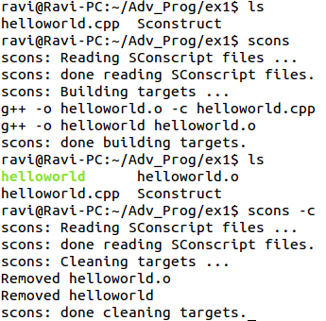
Outlook: Scons Helloworld
Python script file with name Sconstruct
Default build configuration given by
Program(‘helloworld.cpp’)
Provides default options for cleaning project
In-order execution of the script
Notes:
PortabilityMake largely depends on embedded shell scripts to create the target from the dependencies. This makes Makefiles non-portable across systems that have completely different shells, like Linux and Windows.
ReliabilityIn a project consisting of a tree folders, a common technique is to employ hierarchical Makefiles. The problem with this approach is that, when make is building a sub-folder it does to have the complete view of the dependency graph. This leads to incorrect builds. This problem is described in more detail in the paper Recursive Make Considered Harmful
ReproducibilityOS environment variables can greatly affect the build, since make automatically converts all OS environment variables into make variables. The build can vary between systems depending the values set in the environment variables.

Slide 20
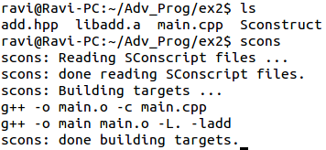
Outlook: Scons with Libraries
Libraries can be added to the build with the LIBRARY attribute
Path to be specified using LIBRARYPATH attribute
User-defined libraries can be built using the LIBRARY command
Library('foo', ['f1.c', 'f2.o'])
#Sconstruct
Program(‘main.cpp’, LIBRARY=‘add’, LIBRARYPATH = ‘ . ’)
Notes:
PortabilityMake largely depends on embedded shell scripts to create the target from the dependencies. This makes Makefiles non-portable across systems that have completely different shells, like Linux and Windows.
ReliabilityIn a project consisting of a tree folders, a common technique is to employ hierarchical Makefiles. The problem with this approach is that, when make is building a sub-folder it does to have the complete view of the dependency graph. This leads to incorrect builds. This problem is described in more detail in the paper Recursive Make Considered Harmful
ReproducibilityOS environment variables can greatly affect the build, since make automatically converts all OS environment variables into make variables. The build can vary between systems depending the values set in the environment variables.

Slide 21
Outlook: Scons - Final remarks
Build environment can be changed by creating a new Construction Environment and setting values of Construction Variables
The ease of use and learning of Scons tool, together with power of Python scripting makes it a very powerful and usable build tool
#Sconstruct
import os
env = Environment(CC = ‘icc', CCFLAGS = '-O2')
env.Program(‘helloworld.cpp')

Slide 22
Eclipse IDE and Debugging
Thank you for your attention!
Any questions?

